Slide 1
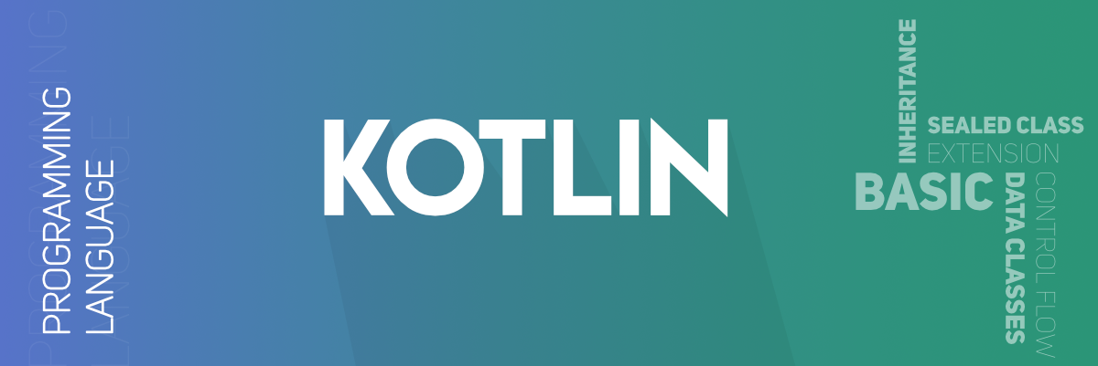
Introduction to Android and Kotlin

Slide 2
What is Kotlin ?
Kotlin = Java + Extra updated new features.
Kotlin is a general-purpose, statically typed, and open-source programming language.
It runs on JVM and can be used anywhere Java is used today.
It can be used to develop Android apps, server-side apps and much more.
It has built world-class IDEs like IntelliJ IDEA, PhpStorm, Appcode, etc.

Slide 3
History of Kotlin
It was first introduced by JetBrains in 2011 as a new language for the JVM.
Kotlin is an object-oriented language.
Kotlin mainly targets the Java Virtual Machine (JVM), but also compiles to JavaScript.
Kotlin is influenced by other popular programming languages such as Java, C#, JavaScript, Scala and Groovy.
Kotlin is sponsored by Google, announced as one of the official languages for Android Development in 2017.

Slide 4
Features of Kotlin
Statically typed – Statically typed is a programming language characteristic that means the type of every variable and expression is known at compile time.
Concise: Kotlin reduces writing the extra codes, it has less boilerplate code.
Null safety: Kotlin is null safety language. Kotlin aimed to eliminate the NullPointerException (null reference)
Interoperable: Kotlin and java code are inter-accessible
Type Inference: Kotlin's compiler can automatically infer the type of a variable based on the assigned value, reducing the need for explicit type declarations
Smart cast: Kotlin automatically casts variables to their correct types when it is safe to do so, simplifying type checks and casting operations. Kotlin has safe casting operator (as?) which returns ‘null’ if cast is not possible , this prevents run time exceptions
Tool-friendly: Kotlin programs are build using the command line as well as any of Java IDE
Multiplatform Support: Kotlin supports multiple platforms, including JVM, Android, JavaScript, and native platforms, allowing for cross-platform development.

Slide 5
Kotlin Drawbacks
Compilation Speed: Kotlin's compilation time can be slower compared to Java in large projects.
Limited Resources: Despite its growing popularity, Kotlin has fewer resources, tutorials, and community support compared to more established languages like Java.
Tooling and IDE Support: Although Kotlin is supported by major IDEs like IntelliJ IDEA and Android Studio, the support is not as mature or extensive as it is for Java, potentially leading to less efficient development workflows.
Runtime Size: Kotlin applications may have a larger runtime size compared to Java applications, which can be a concern for Android developers trying to minimize the apk file size
Frequent Updates: The Kotlin language and its ecosystem are evolving rapidly, which can lead to frequent updates and the need to keep up with changes, potentially causing compatibility issues with existing code.

Slide 6
Applications of Kotlin language
Android Development : It is widely used for building Android applications due to its concise syntax, null safety features, and interoperability with Java. Major apps like Pinterest, Trello, Evernote, and Netflix have adopted Kotlin for their Android development.
Server-Side Development : Kotlin can be used to build server-side applications using frameworks like Ktor, Spring, and Vert.x. Kotlin is suitable for developing microservices, benefiting from its concise code and interoperability with Java-based microservices frameworks.
Web Development : Kotlin enables full-stack development by allowing developers to use the same language for both backend and frontend development.
Multiplatform Development : this feature allows developers to share code across different platforms, including Android, iOS, web, and desktop applications. It facilitates code reuse and reduces duplication.
Data Science and Machine Learning : Kotlin can be used for data processing and analysis with libraries like KotlinDL (Deep Learning), Kotlin Statistics. Kotlin can leverage existing Java libraries and frameworks for data science, such as Apache Spark, Deeplearning4j, and Weka.
Desktop Applications : Kotlin can be used to develop desktop applications using JavaFX, providing a modern alternative to Swing.
IoT Applications: Kotlin can be used to develop applications for IoT devices, leveraging its concise syntax and interoperability with Java-based IoT frameworks.
Coroutines: Kotlin's coroutines provide an efficient way to handle concurrency and parallelism, making it suitable for applications that require high performance and responsiveness, such as real-time data processing and network applications.

Slide 7
Kotlin Jobs Opportunity
Kotlin is very high in demand and all major companies are moving towards Kotlin to develop their web and mobile applications. Average annual salary for a Kotlin developer is around ₹ 3.6 Lakhs to ₹ 35.0 Lakhs . Following are the great companies who are using Kotlin:
Google
Amazon
Netflix
Pinterest
Uber
Trello
Coursera
Basecamp
Corda
JetBrains
Many more...

Slide 8
Installing Kotlin
Like Java, Kotlin also runs on JVM therefore to install Kotlin on Windows directly and work with it using the command line You need to make sure you have JDK installed in your system.
Verifying the Java installation
To verify Java installation −
C:\> java -version
If Java is not intalled on your system than You can install JDK Java SE 8 or higher version

Slide 9
Install IDE for Kotlin
There are various Java IDE available which supports Kotlin project development. We can choose these IDE according to our compatibility. The download links of these IDE's are given below.
IDE Name | Download links
IntelliJ IDEA | https://www.jetbrains.com/idea/download/
Android Studio | https://developer.android.com/studio/preview/index.html
Eclipse | https://www.eclipse.org/downloads/

Slide 10
Kotlin - Basic Syntax
Program Entry Point - An entry point of a Kotlin application is the main() function. A function can be defined as a block of code designed to perform a particular task.
fun main()
Entry Point with Parameters- Another form of main() function accepts a variable number of String arguments as follows:
fun main(args: Array<String>)

Slide 11
print() vs println()
The print() is a function in Kotlin which prints its argument to the standard output, similar way the println() is another function which prints its argument on the standard output but it also adds a line break in the output.

Slide 12
Kotlin - Comments
Kotlin supports single-line (or end-of-line) and multi-line (block) comments.
// This is single-line comment
/* This is a
multi-line
comment */

Slide 13
KEYWORDS IN KOTLIN
Kotlin keywords are predefined, reserved words used in Kotlin programming that have special meanings to the compiler.
These words cannot be used as an identifier (variables names, package names, function names etc.)
Program will not compile when keywords are used as identifiers.

Slide 14
fun main(args: Array<String>) {
var a=40
print(a)
var try = 40
print(try)
}
The code shown alongside will give error because “try” is a reserved keyword.
Replace the “try” keyword with some other variable name to make code work
Reserved keywords can be used as special identifiers by using backtick (`) if required
fun main(args: Array<String>) {
var a=40
print(a)
var `try` = 40
print(`try`)
}

Slide 15

Variables
They are the names you give to computer memory locations which are used to store values in a computer program and later you use those names to retrieve the stored values and use them in your program.
Kotlin variables are created using either var or val keywords and then an equal sign = is used to assign a value to those created variables. Mentioning the type of variable is optional in Kotlin
var name = ”Shyam”
var age = 19
var height = 5.2

Slide 16
DECLARING VARIABLES
Mutable Variables: declared using keyword `var`. These can be changed after initialization
var age: Int = 25
age = 26 // Valid because age is a mutable variable
Immutable Variables: declared using keyword `val`. These cannot be changed once initialized.
val age: Int = 25
age = 26 //will give error since age is immutable variable

Slide 17
Kotlin Variable Naming Rules
Kotlin variable names can contain letters, digits, underscores, and dollar signs.
Kotlin variable names should start with a letter or underscore
Kotlin variables are case sensitive which means LPU and lpu are two different variables.
Kotlin variable can not have any white space or other control characters.
Kotlin variable can not have names like var, val, String, Int because they are reserved keywords in Kotlin.

Slide 18
Variable Initialization
Value can be assigned to a variable either at Initialization or anywhere else in the program
Value of an immutable variable can be assigned only once and for a mutable variable value can be changed as and when required
If a variable is not initialized while defining it, then it is compulsory to mention the type of variable
fun main()
{
var a = 10 //initialized while defining variable
var b:Int //defined but not initialized
var c: Int
b = 20
c=a+b
print(c)
}

Slide 19
Type Inference
Kotlin can infer the type from the assigned value
fun main()
{
var a = 10 // Type is inferred as Integer
var b = 12.123 // Type is inferred as Float
var c = "hello" // Type is inferred as String
var d = true // Type is inferred as Boolean
}

Slide 20
Accessing Variables
To read the value from a variable simply use the variable name
fun main()
{
var age: Int = 25
println(age)
}

Slide 21
Variables inside functions and Class
Variables declared inside a function are only accessible within that function
Variables declared inside a class can be accessed by all methods in the class
class Person
{
var name: String = "John Doe"
val age: Int = 30
fun displayInfo()
{
println("Name: $name, Age: $age")
} }
fun main()
{
val person = Person()
person.displayInfo()
}
fun greet()
{
val message: String = "Hello, Kotlin!"
println(message)
}
println(message) //this will give error since variable msg is declared inside the function greet therefore only accessible inside the function

Slide 22
String Interpolation with $
String interpolation allows you to insert variable values directly into a string using the $ symbol.
String interpolation can also be directly used to evaluate expressions
fun main()
{
val a = 10
val b = 20
val result = "Sum of $a and $b is ${a+b}"
println(result)
}

Slide 23
Data Types
Kotlin treats everything as an object which means that we can call member functions and properties on any variable.
Kotlin is a statically typed language, which means that the data type of every expression should be known at compile time.
Number
Character
String
Boolean
Array

Slide 24
Kotlin Number Data Types
Numeric values and they are divided into two groups:
(a) Integer types store whole numbers, +ve or –ve
val a: Int = 10000
(b) Floating point numbers with a fractional part, containing one or more decimals.
val f: Float = 100.00f
Data Type | Size (bits) | Data Range
Byte | 8 bit | -128 to 127
Short | 16 bit | -32768 to 32767
Int | 32 bit | -2,147,483,648 to 2,147,483,647
Long | 64 bit | -9,223,372,036,854,775,808 to +9,223,372,036,854,775,807
Float | 32 bit | 1.40129846432481707e-45 to 3.40282346638528860e+38
Double | 64 bit | 4.94065645841246544e-324 to 1.79769313486231570e+308

Slide 25
Kotlin Character Data Type
Kotlin character data type is used to store a single character and they are represented by the Char keyword.
Char value must be surrounded by single quotes, like 'A' or '1’.
Syntax : val name: Char = 'A’
Kotlin supports a number of escape sequences of characters. When a character is preceded by a backslash (\), it is called an escape sequence and it has a special meaning to the compiler.
fun main()
{
val letter: Char // defining a Char variable
letter = 'A' // Assigning a value to it
print("$letter")
print('\n') //prints a newline character
print('\$') //prints a dollar $ character
print('\\') //prints a back slash \ character
}

Slide 26
Kotlin String Data Type
The String data type is used to store a sequence of characters.
String values must be surrounded by double quotes (" ") or triple quote (""" """).
We have two kinds of string available in Kotlin
Escaped String is declared within double quote (" ") and may contain escape characters like '\n', '\t', '\b' etc.
Raw string is declared within triple quote (""" """) and may contain multiple lines of text without any escape characters.
val x : String = "I am escaped String!\n"
var y :String = """This is going to be a
multi-line string and will
not have any escape sequence""";

Slide 27
Kotlin Boolean Data Type
Boolean is very simple like other programming languages. We have only two values for Boolean data type - either true or false
val A: Boolean = true
// defining a variable with true value

Slide 28
Kotlin Data Type Conversion
Type conversion is a process in which the value of one data type is converted into another type. Kotlin does not support direct conversion of one numeric data type to another. It has predefined TYPE CHECKING option.
To convert a numeric data type to another type, Kotlin provides a set of functions:
toByte()
toShort()
toInt()
toLong()
toFloat()
toDouble()
toChar()

Slide 29
Array Data Type
An array is a collection of elements of the same type, stored in contiguous memory locations.
Arrays are useful for storing multiple items of the same data type.
In Kotlin, arrays are represented by the ‘Array’ class.

Slide 30
fun main()
{
// Array of integers
val numbers = arrayOf(1, 2, 3, 4, 5)
// Array of strings
val words: Array<String> = arrayOf("Kotlin", "Java", "Python")
// Array of squares using lambda function
val squares = Array(5) { i -> i * i }
// Accessing elements
val firstNumber = numbers[0] // First element
val secondWord = words[1] // Second element
println("First number: $firstNumber")
println("Second word: $secondWord")
// Modifying elements
numbers[0] = 10 // Modify first element
words[1] = "Kotlin" // Modify second element
println("Modified first number: ${numbers[0]}")
println("Modified second word: ${words[1]}")
// iterating over arrays
// Using for loop
println("Numbers array using for loop:")
for (num in numbers)
{
println(num)
}
// Using forEach function
println("Words array using forEach:")
words.forEach { word -> println(word) }
// Using indices property
println("Squares array using indices:")
for (i in squares.indices)
{
println("Element at index $i is ${squares[i]}") }
// properties of array
val size = numbers.size // Array size
println("Size of numbers array: $size")
// isEmpty and isNotEmpty functions
if (numbers.isEmpty())
{
println("Numbers array is empty") }
else
{ println("Numbers array is not empty")
val firstElement = numbers.first() // First element
val lastElement = numbers.last() // Last element
println("First element: $firstElement")
println("Last element: $lastElement")
val index = words.indexOf("Kotlin") // Index of an element
println("Index of 'Kotlin': $index")
}
}

Slide 31
Multidimensional Arrays
Additional Array Examples
fun main()
{
// Creating a 2D array (matrix)
val matrix: Array<Array<Int>> = arrayOf( arrayOf(1, 2, 3), arrayOf(4, 5, 6), arrayOf(7, 8, 9) )
println("Element at row 0, column 1: ${matrix[0][1]}")
}
fun main()
{
// Creating primitive type arrays
val floatArray = floatArrayOf(1.1f, 2.2f, 3.3f)
val intArray = intArrayOf(10, 20, 30)
val doubleArray = doubleArrayOf(1.1, 2.2, 3.3)
println("Float array: ${floatArray.joinToString(", ")}")
println("Int array: ${intArray.joinToString(", ")}")
println("Double array: ${doubleArray.joinToString(", ")}")
// Type conversion example
val convertedInt = doubleArray[0].toInt()
// Converting double to int
println("Converted double to int: $convertedInt")
}

Slide 32
Find the Error……
fun main(args: Array<String>)
{
val x: Int = 100
val y: Long = x
println(y)
}

Slide 33
// Here x is integer type of variable, thus it cannot be stored y due to type mismatch //corrected code
fun main(args: Array<String>)
{
val x: Int = 100
val y: Long = x.toLong()
println(y)
}

Slide 34
Safe and Unsafe Casting
Safe Cast : done using ‘as?’ keyword. It returns null if cast is not possible
Unsafe Cast : done using ‘as’ keyword. It throws a ClassCastException if cast is not possible

Slide 35
fun main()
{
// List containing various types of student information
val studentInfo: List<Any> = listOf( 101, // Student ID
"Alice", // Student name
3.5, // Student GPA
102, // Student ID
"Bob", // Student name
3.8 // Student GPA
)
// Processing the student information
for (info in studentInfo) {
when (info)
{ is Int -> println("Student ID: $info") // Handling student IDs
is String -> println("Student Name: $info") // Handling student names
is Double -> println("Student GPA: $info") // Handling student GPAs
else -> println("Unknown information type")
}
}
// Safe cast example: Trying to get the student name safely
val studentName: Any = studentInfo[1]
val safeStudentName: String? = studentName as? String
println("Safe cast result: $safeStudentName")
// Unsafe cast example: This will cause an exception if uncommented
// val studentId: Any = studentInfo[1]
// val unsafeStudentId: Int = studentId as Int
// This will throw ClassCastException
// println("Unsafe cast result: $unsafeStudentId")
// Type conversion example: Converting GPA to integer
val gpa: Any = studentInfo[2]
if (gpa is Double)
{
val intGpa = gpa.toInt() // Convert Double to Int
println("Converted GPA to integer: $intGpa")
}
}

Slide 36
Operator
An operator is a symbol that tells the compiler to perform specific mathematical or logical manipulations on operands (values or variable). Kotlin is rich in built-in operators and provide the following types of operators:
Arithmetic operator
Relation operator
Assignment operator (Compound Assignments)
Unary operator
Logical operator
Bitwise operator

Slide 37
Arithmetic Operators
Operator | Description | Expression | Translate to
+ | Addition | a+b | a.plus(b)
- | Subtraction | a-b | a.minus(b)
* | Multiply | a*b | a.times(b)
/ | Division | a/b | a.div(b)
% | Modulus | a%b | a.rem(b)

Slide 38
Relational Operators
Operators | Meaning | Expression | Translate to
> | greater than | a > b | a.compareTo(b) > 0
< | less than | a < b | a.compareTo(b) < 0
>= | greater than or equal to | a >= b | a.compareTo(b) >= 0
<= | less than or equal to | a <= b | a.compareTo(b) <= 0
== | is equal to | a == b | a?.equals(b) ?: (b === null)
!= | not equal to | a != b | !(a?.equals(b) ?: (b === null)) > 0
Note: ? means it could be NULL possible

Slide 39
Assignment Operators
Operators | Expression | Translate to
+= | a = a + b | a.plusAssign(b) > 0
-= | a = a – b | a.minusAssign(b) < 0
*= | a = a * b | a.timesAssign(b)>= 0
/= | a = a / b | a.divAssign(b) <= 0
%= | a = a % b | a.remAssign(b)

Slide 40
Unary Operators
Operator | Description | Expression | Convert to
+ | unary plus | +a | a.unaryPlus()
- | unary minus | -a | a.unaryMinus()
++ | increment by 1 | ++a | a.inc()
-- | decrement by 1 | --a | a.dec()
! | not | !a | a.not()

Slide 41
Logical Operators
Operator | Name | Description | Example
&& | Logical and | Returns true if both operands are true | x && y
|| | Logical or | Returns true if either of the operands is true | x || y
! | Logical not | Reverse the result, returns false if the operand is true | !x

Slide 42
Bitwise Operators
Function | Description | Example
shl (bits) | signed shift left | x.shl(y)
shr (bits) | signed shift right | x.shr(y)
ushr (bits) | unsigned shift right | x.ushr(y)
and (bits) | bitwise and | x.and(y)
or (bits) | bitwise or | x.or(y)
xor (bits) | bitwise xor | x.xor(y)
inv() | bitwise inverse | x.inv()

Slide 43
fun main() {
var a = 10
var b = 5
val isTrue = true
val isFalse = false
val add = a + b
//arithmetic operators
println("Addition: $a + $b = $add")
println("Multiplication: $a * $b = ${a*b}")
//comparison operators
val isEqual = a == b
println("$a == $b: $isEqual")
println("$a > $b: ${a>b}")
// Logical Operators
val andResult = isTrue && isFalse
val notResult = !isTrue
println("$isTrue && $isFalse: $andResult")
println("!$isTrue: $notResult")
// Assignment Operators
var c = a
c += b
val inc = c
println("c += $b: $inc")
// Bitwise Operators
val e = 5 // 0101 in binary
val f = 3 // 0011 in binary
val andBitwise = e and f
println("$e and $f: $andBitwise")
// Range and Iterator Operators
val range = 1..5
println("Range: $range")
println("Numbers in range:")
for (i in range) {
print("$i ")
}
println()
}

Slide 44
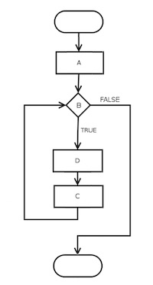
Control Flow
Kotlin flow control statements determine the next statement to be executed. For example, the statements if-else, if, when, while, for, and do are flow control statements.

Slide 45
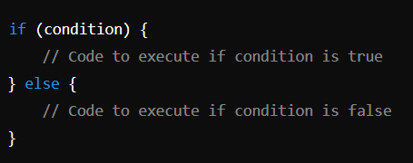
IF-ELSE
The If-Else statements in Kotlin are fundamental control flow constructs that allow a program to make decisions based on certain conditions.
They help control the flow of execution depending on whether a condition is true or false.
Syntax:

Slide 46
Simple if Statement
if-else Statement
fun main()
{
val temperature = 25
if (temperature > 20)
{
println("It's a warm day.")
}
}
fun main()
{
val age = 18
if (age >= 18) {
println("You are an adult.")
}
else {
println("You are a minor.")
}
}

Slide 47
if-else if-else Ladder
Nested if Statements
fun main()
{
val score = 85
if (score >= 90) {
println("Grade: A")
}
else if (score >= 80) {
println("Grade: B")
}
else if (score >= 70) {
println("Grade: C")
}
else {
println("Grade: D")
}
}
fun main()
{
val age = 20
val hasID = true
if (age >= 18) {
if (hasID) {
println("You can enter the club.")
}
else {
println("ID required to enter the club.")
}
}
else {
println("You are too young to enter the club.")
}
}

Slide 48
Real Life Application
Design a Kotlin program for a store to determine eligibility for a special offer based on the total amount and membership status.
Instructions:
Create a Kotlin program that simulates a discount system for a store.
Define two variables:
A variable representing the total amount of purchase.
A variable indicating whether the customer has a membership.
Implement the following logic:
If the total amount of the purchase is either 1000 or more then:
a) Check if the customer has a membership.
If they do, print a message indicating a 20% discount.
If they do not, print a message indicating a 10% discount.
If the total amount of the purchase is below the threshold, print a message indicating no discount.

Slide 49
fun main()
{
val purchaseAmount = 1500
val hasMembership = true
if (purchaseAmount >= 1000) {
if (hasMembership) {
println("Congratulations! You are eligible for a 20% discount.")
}
else {
println("You are eligible for a 10% discount.")
}
}
else {
println("No discount available.")
}
}

Slide 50
When
Consider a situation when you have large number of conditions to check.
It can be done with if..else if expression but Kotlin provides when expression to handle the situation in a better and clean way
Kotlin when expression is similar to the switch statement in C, C++ and Java.

Slide 51
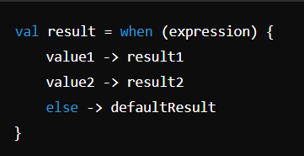
‘when’ as an Expression
When used as an expression, ‘when’ returns a value that can be assigned to a variable or used directly in expressions.
Syntax:
fun main()
{
val dayOfWeek = 3
val dayName = when (dayOfWeek) {
1 -> "Monday "
2 -> "Tuesday"
3 -> "Wednesday"
4 -> "Thursday"
5 -> "Friday "
6 -> "Saturday"
7 -> "Sunday"
else -> "Invalid day"
}
println("Day of the week: $dayName")
}

Slide 52
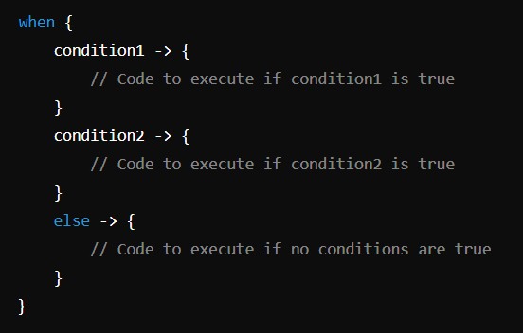
‘when’ as a statement
When used as a statement, when executes different code blocks based on the condition but does not return a value.
Syntax:
fun main()
{
val number = 8
when {
number % 2 == 0 -> println("$number is even")
number % 2 != 0 -> println("$number is odd")
//else -> println("Unexpected number")
}
}

Slide 53
‘For’ Loop
The for loop in Kotlin is used to iterate over a range of values, collections, or arrays.
It's an essential control flow construct for repeating operations and working with sequences of data
Kotlin for loop iterates through anything that provides an iterator ie. that contains a countable number of values
The for loop in Kotlin can be used in different ways depending on what you're iterating over.

Slide 54
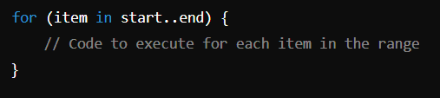
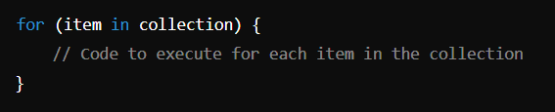
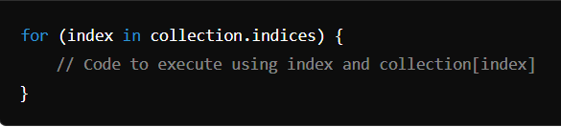
Syntax of ‘for’ Loop
Syntax for Ranges:
Syntax for Collections (e.g., Lists, Arrays):
Syntax for Iterating with Index:

Slide 55
For loop for Ranges
Both ends of range inclusive
Upper end excluded
fun main()
{
for (i in 1..5) {
println("Number: $i")
}
}
fun main() {
for (i in 1 until 5) {
println("Number: $i")
}
}

Slide 56
Reverse loop
Reverse with step size
fun main(args: Array<String>)
{
for (item in 5 downTo 1 ) {
println(item)
}
}
fun main(args: Array<String>)
{
for (item in 5 downTo 1 step 2 ) {
println(item)
}
}

Slide 57
Iterating over a List
When only elements need to be accessed
When both element and index of the element need to be accessed
fun main()
{
val fruits = listOf("Apple", "Banana", "Cherry")
for (fruit in fruits) {
println("Fruit: $fruit")
}
}
fun main()
{
val fruits = listOf("Apple", "Banana", "Cherry")
for (index in fruits.indices) {
println("Fruit at index $index is ${fruits[index]}")
}
}

Slide 58
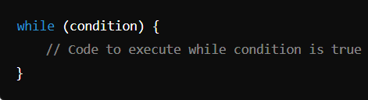
‘While’ loop
While loop repeatedly executes a block of code as long as the specified condition is true.
Syntax:
fun main()
{
var i = 5
while (i > 0) {
println("value is: $i")
i--
}
}
// Think what will happen if counter is incremented instead of decrementing
// Try to change condition to i>5

Slide 59
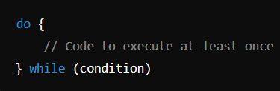
do- while loop
Do-while loop executes a block of code once before checking the condition, and then repeats the loop as long as the condition is true.
Syntax:
fun main()
{
var i = 5
do {
println("value: $i")
i--
}
while (i > 5) }
// even though the condition i>5 is false since beginning but still loop executes once, this is basic diff between while and do-while loop

Slide 60
Real life application
Write a Kotlin program that simulates a simple banking system. In this system, a user can repeatedly withdraw money from their account until they decide to stop. Implement the following features:
Initial Balance: Start with a predefined account balance (e.g., 1000).
Withdrawal Process: Prompt the user to enter an amount to withdraw.
a) If the entered amount is greater than the current balance, print a message indicating insufficient funds.
b) If the entered amount is within the balance, deduct it from the balance and print the new balance.
Continue Prompt: After each withdrawal, ask the user if they want to make another withdrawal (yes/no).
Termination: When the user inputs "no", print a thank you message and terminate the program.

Slide 61
fun main()
{
var bal = 1000
var withdraw: Int
var cont: String
do {
println("Your current balance is: $bal")
println("Enter amount to withdraw: ")
withdraw = readLine()?.toInt() ?: 0
if (withdraw <= bal) {
bal -= withdraw
println("Withdrawal successful! New balance: $bal")
}
else {
println("Insufficient balance!")
}
println("Do you want to make another withdrawal? (yes/no): ")
cont = readLine() ?: "no" }
while(cont.equals("yes", ignoreCase = true))
println("Thank you for using our service!")
}

Slide 62
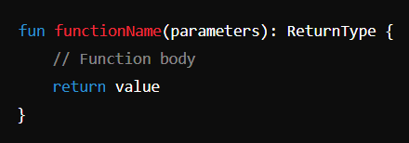
Functions in Kotlin
Functions are reusable blocks of code that perform a specific task. They help in reducing code duplication and improving readability and maintainability
Functions are also known as methods or subroutines
Functions can take input (parameters) and return output (return type)
Syntax :
Note that parameters and return type are optional

Slide 63
Built-in Functions
User defined functions
Kotlin provides a number of built-in functions to provide basic functionality
print()
println()
str.length()
readline()
touppercase()
tolowercase ()
listof ()
fun demo()
{
println("Hello, World!")
}
fun main(args: Array<String>) {
demo()
}

Slide 64
Functions Based on types of arguments
Default Arguments
Without default Arguements
fun sum(a:Int=10, b:Int=20)
{
val c=a+b
println(c)
}
fun main() {
sum(20,50)
sum()
}
fun sum(a:Int, b:Int)
{
val c=a+b
println(c)
}
fun main() {
sum(20,50)
sum() //this line will give error
}

Slide 65
Returning values from a function
It is optional for a Kotlin function to return a value.
o return a value, use the return keyword
return type is specified after the function's parentheses
If a function does not return a useful value, its return type by default is referred to as Unit.
fun main(args: Array<String>) {
val a = 10
val b = 20
val result = sum(a, b)
println( result )
}
fun sum(a:Int, b:Int):Int{
val x = a + b
return x
}

Slide 66
Create a function to convert temperatures from Celsius to Fahrenheit and vice versa.
//Convert Celsius to Fahrenheit
fun CtoF(celsius: Double): Double {
return celsius * 9 / 5 + 32
}
// Function to convert Fahrenheit to Celsius
fun FtoC(fahrenheit: Double): Double {
return (fahrenheit - 32) * 5 / 9
}
fun main() {
// Read and convert input values safely
val celsiusInput = readLine()
val fahrenheitInput = readLine()
// Convert to Double, handling null and invalid input cases
val celsius = celsiusInput?.toDoubleOrNull()
val fahrenheit = fahrenheitInput?.toDoubleOrNull()
if (celsius != null) {
println("$celsius°C is equal to ${CtoF(celsius)}°F")
} else {
println("Invalid input for Celsius.")
}
if (fahrenheit != null) {
println("$fahrenheit°F is equal to ${FtoC(fahrenheit)}°C")
} else {
println("Invalid input for Fahrenheit.")
}
}

